Slide 1
Exceptions and Exception Handling
Session 3

Slide 2
EXCEPTION
An exception is an error that happens during execution of a program. When that error occurs, Python generates an exception that can be handled, which avoids your program to crash
Why handle it?
Syntax errors vs exceptions?
Exception classes?

Slide 3
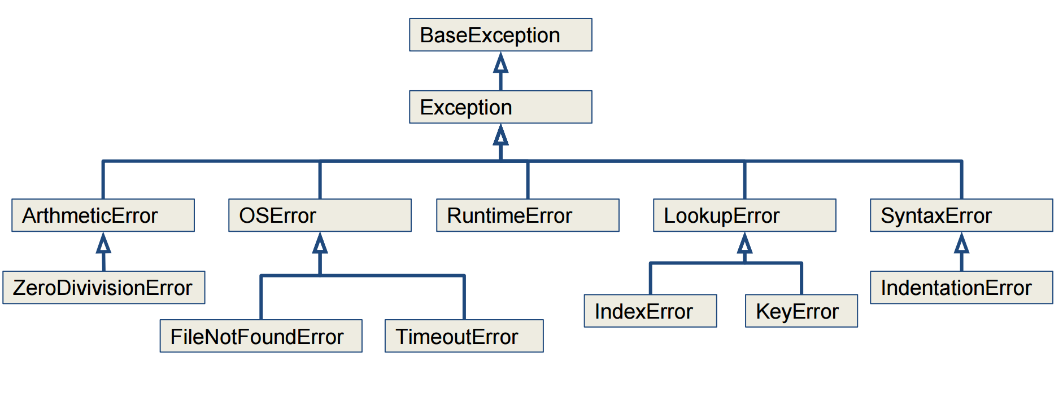
Exception classes

Slide 4
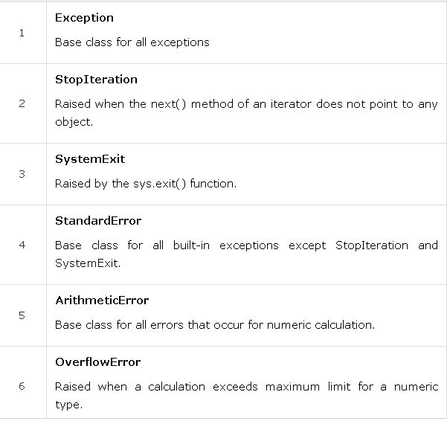

Slide 5
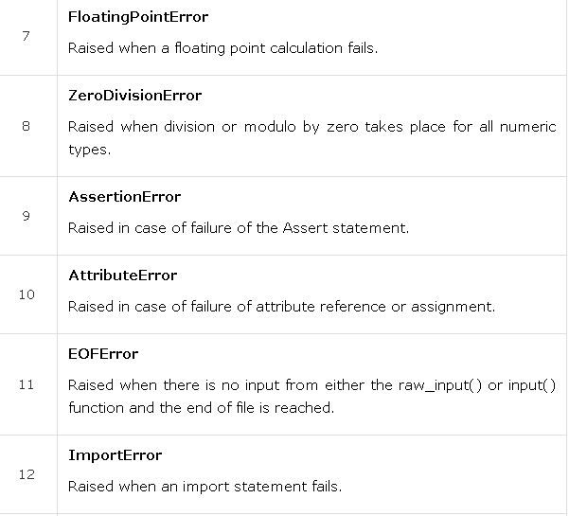

Slide 6
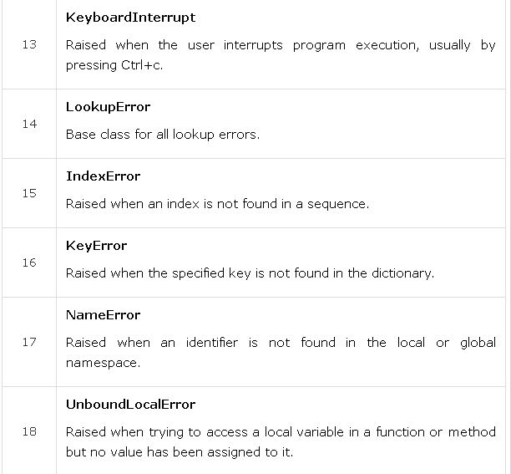

Slide 7
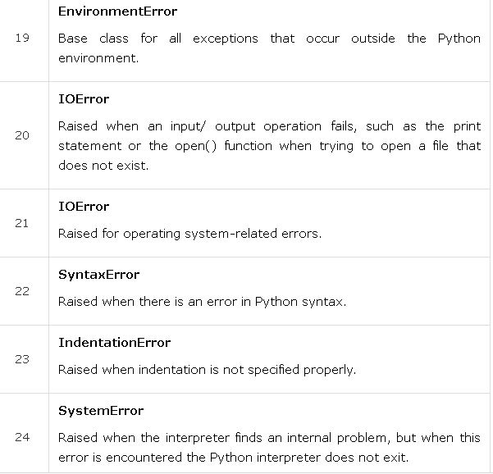

Slide 8
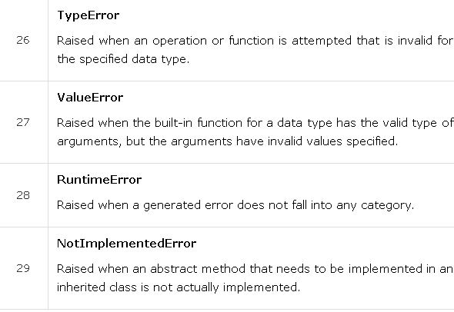

Slide 9
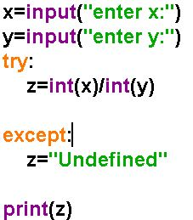
Handling exceptions
Blank Exception statements

Slide 10
WAP to enter
1] 2 numbers x,y
2]create a fun ‘enter’ to get the two numbers and return them
3] create a fun ‘div’ to divide the two numbers
4] use try n except to take care of possible errors(divide by zero)

Slide 11
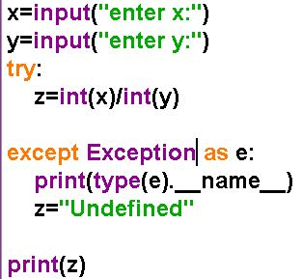
Using exception Classes

Slide 12
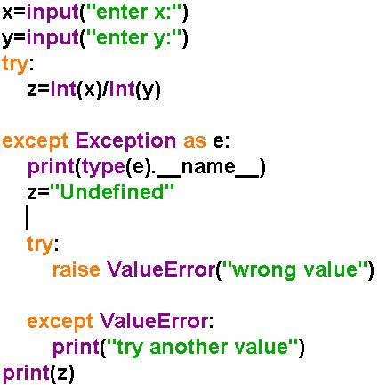
Handling Multiple exceptions and raising exceptions

Slide 13
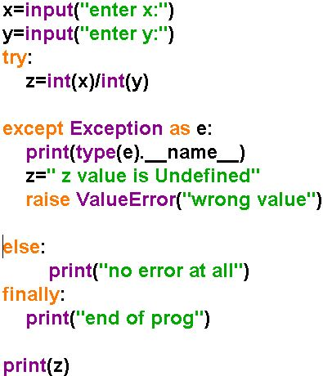
Else…finally

Slide 14
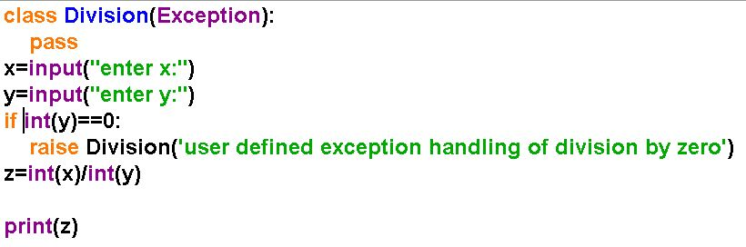
Create your own exception

Slide 15
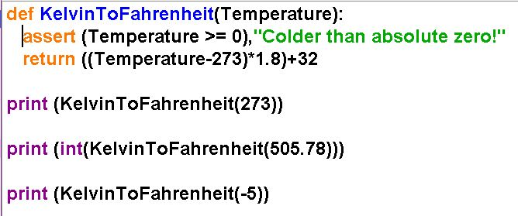
Assertions

